Slide 1

DCAC INSTITUTIONAL REPOSITORY
(D-Space)
An “institutional repository” is a centralized platform that stores and shares scholarly work, enhancing collaboration and visibility. It provides easy access to resources like previous years' question papers, research papers, theses, departmental reports, and records of college activities, etc., supporting both student learning and faculty research while preserving the institution's intellectual output.
Notes:
Are your classroom colors different than what you see in this template? That’s OK! Click on Design -> Variants (the down arrow) -> Pick the color scheme that works for you!
Feel free to change any “You will…” and “I will…” statements to ensure they align with your classroom procedures and rules!

Slide 2
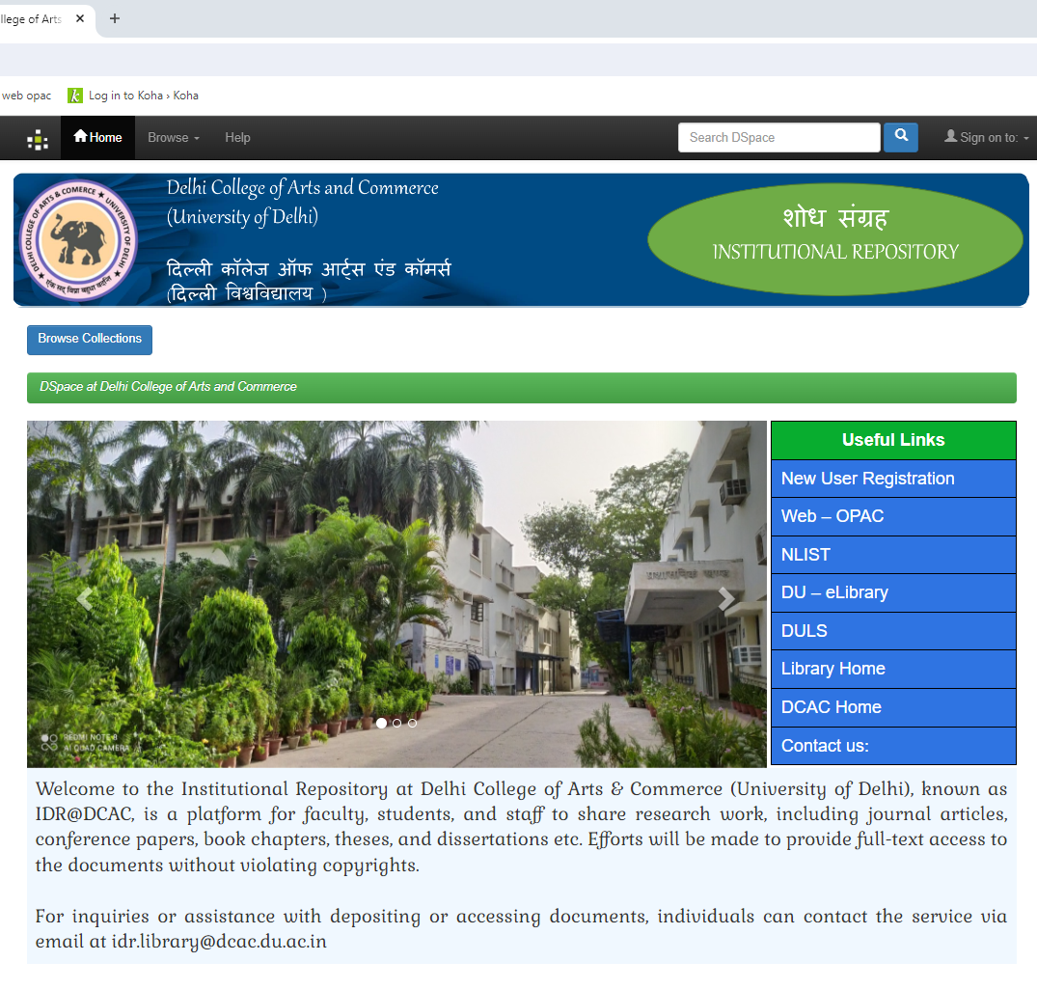
Steps to Access institutional repository (D-Space)
Step 1: Launch a web browser, go to http://dcac.dspaces.org/ and wait for the home page of the institutional repository.

Slide 3
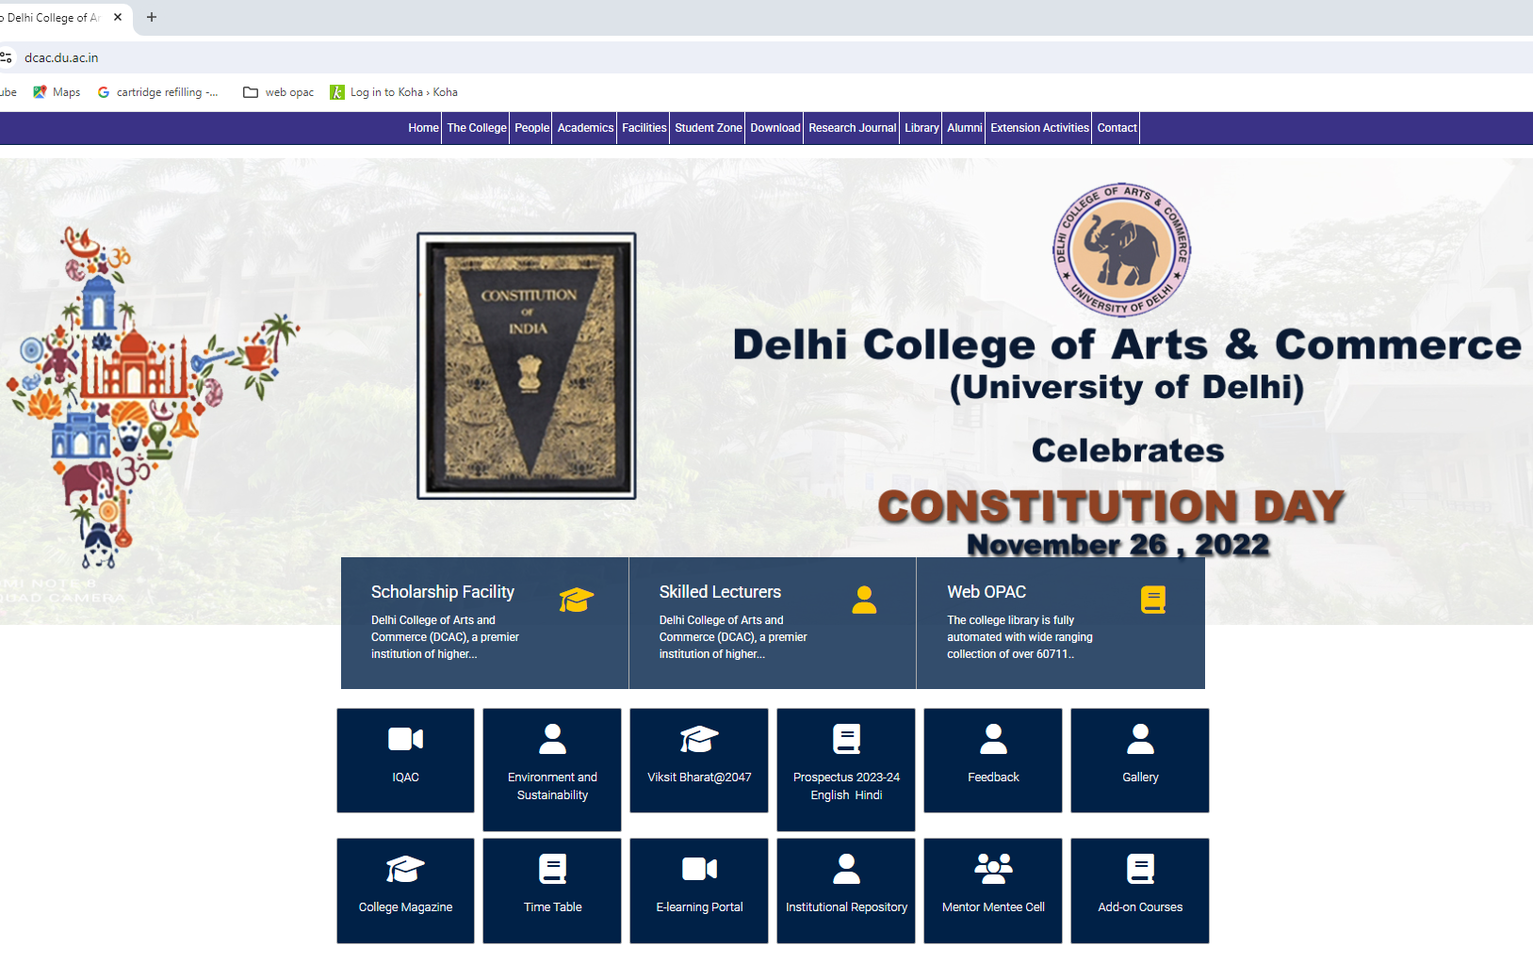
Step 2: Alternative Access Clicking on the “Institutional Repository ” icon available on the DCAC college website.

Slide 4
Step 3: To access resources in the institutional repository, users must be registered through the new user registration process, using the college email ID provided by the institution.

Slide 5
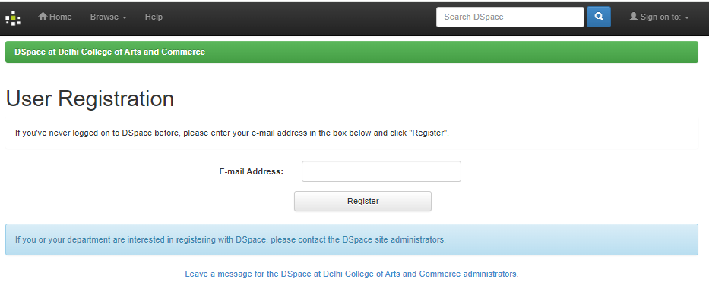
Step 4 : Students and faculty use their college email ID (e.g., ****@dcac.du.ac.in) to complete the registration process and then click the "Register" button.

Slide 6
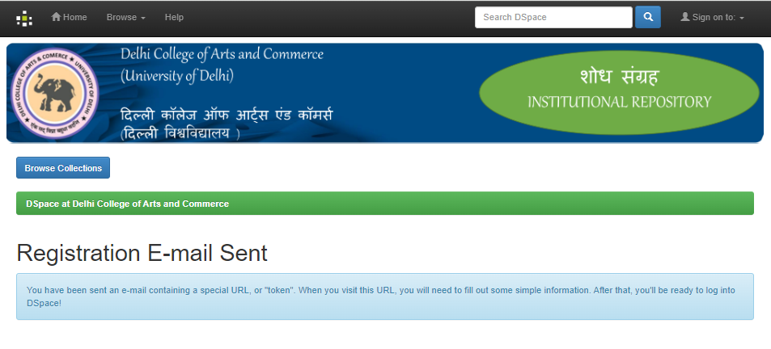
Step 5: After receiving the registration email, users will be able to access the institutional repository resources.

Slide 7
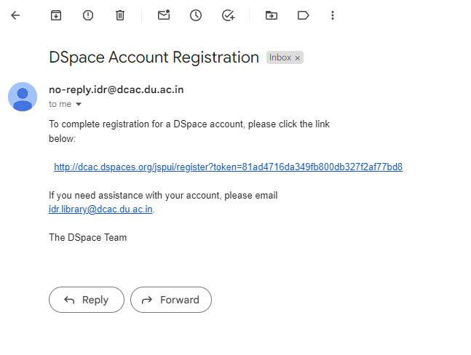
Step 6: To complete your registration for the institutional repository (D-Space) account, please click the link below.

Slide 8
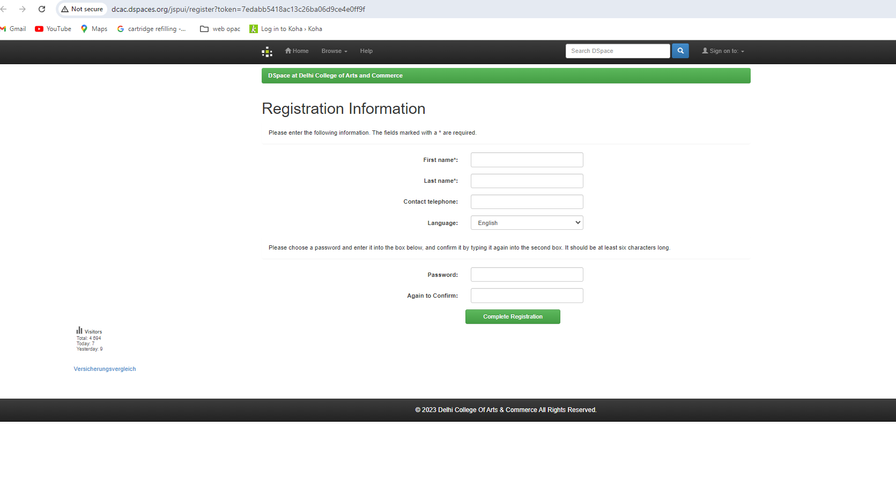
Step 7: Please enter the following information and click "Complete Registration."

Slide 9
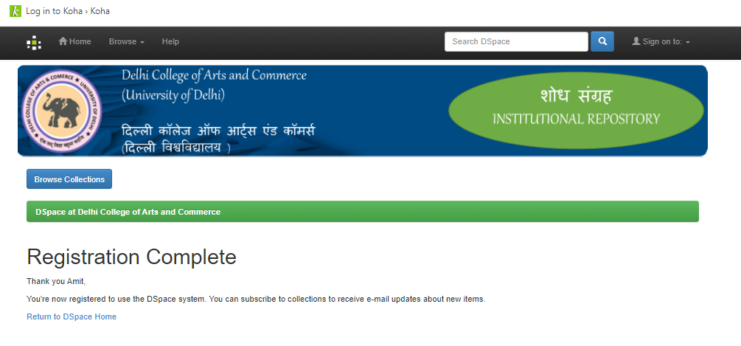
Step 8: After submitting your information, your registration is complete.

Slide 10
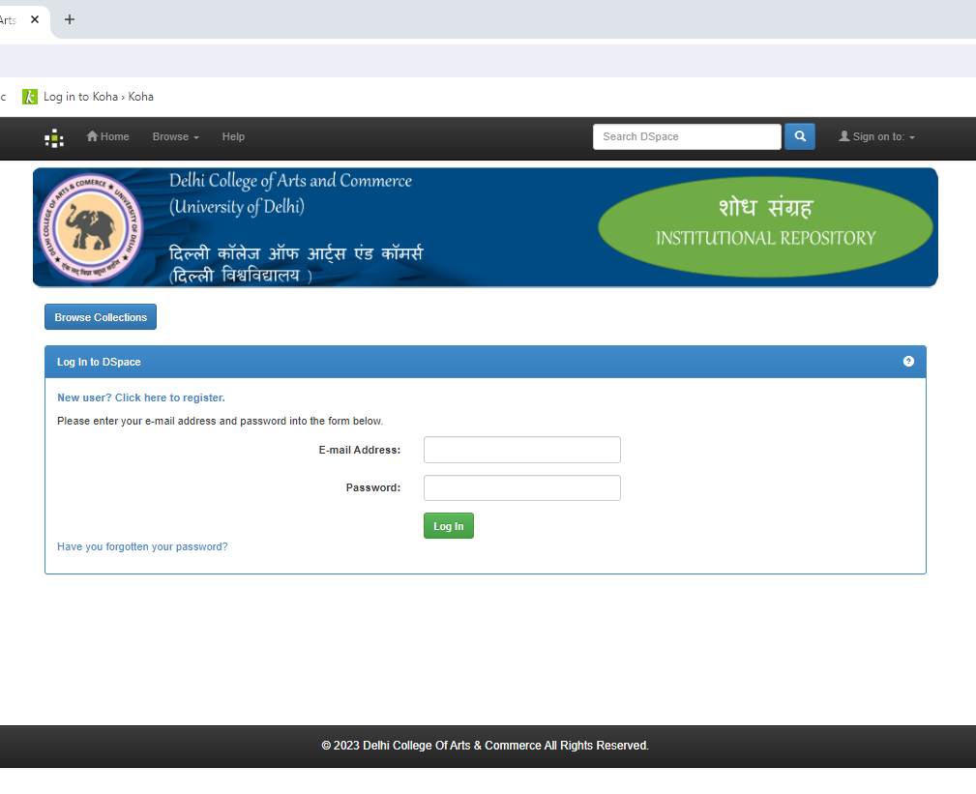
Step 9: To log in to D-Space, users can access their institutional repository account using their registered email ID and password.

Slide 11
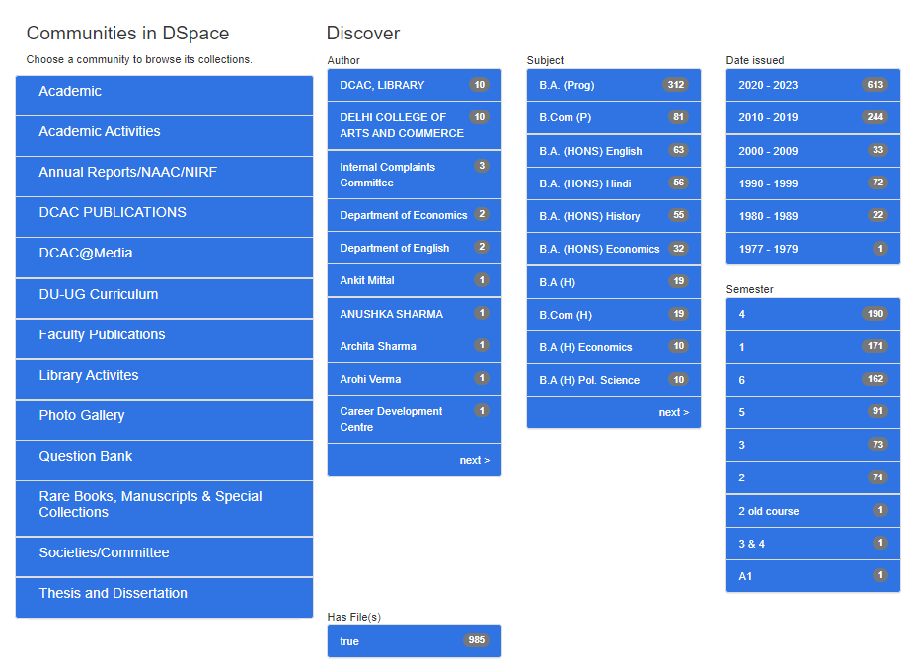
Step 10 : After logging in, users can access resources such as the question bank, library activities, annual reports, theses, and dissertations through the available communities. For example, click on the "Question Bank" community.

Slide 12
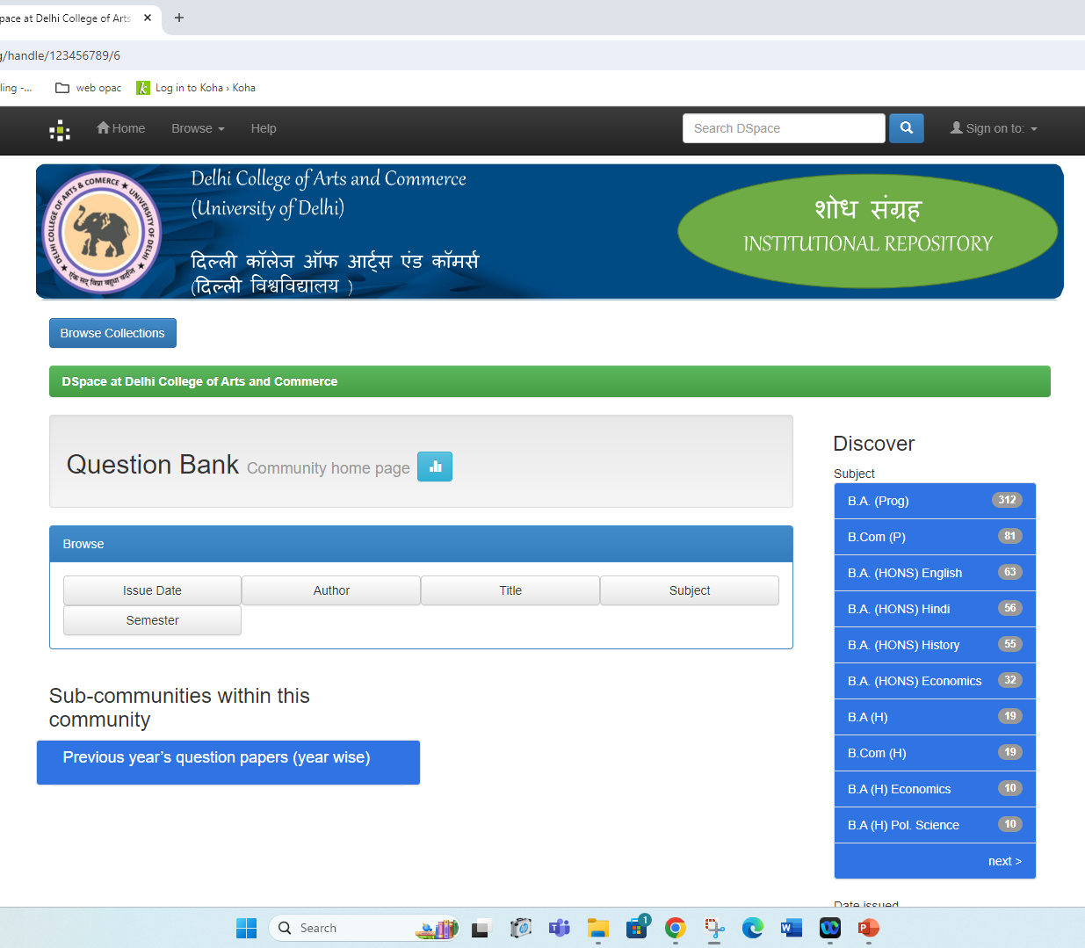
Step 11: After clicking on the "Question Bank" community, you'll find sub-communities within, such as "Previous Year Question Papers" organized by year.

Slide 13
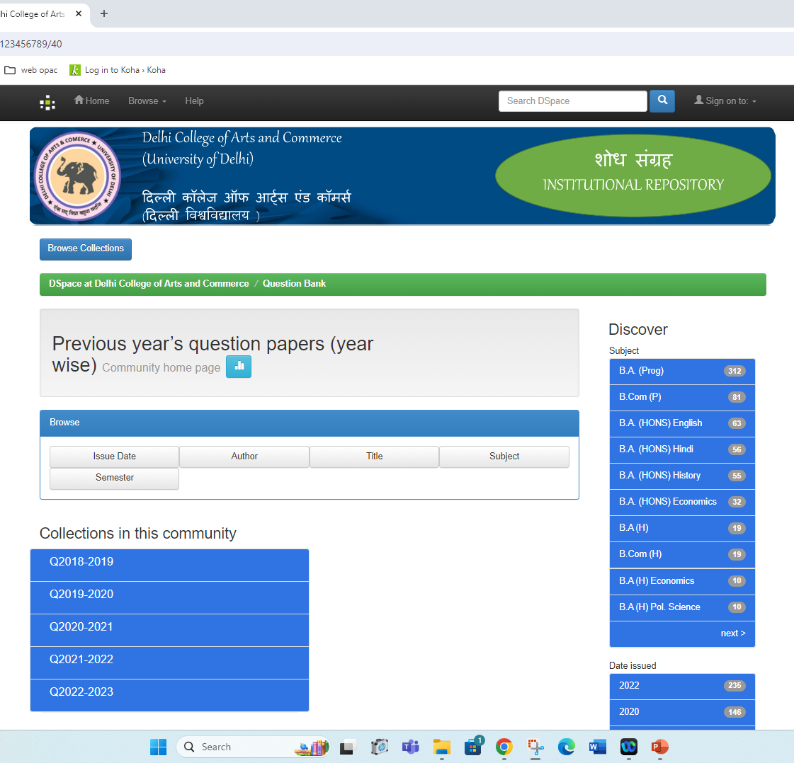
Step 12 : Here, you can access previous years' question papers organized by year.

Slide 14
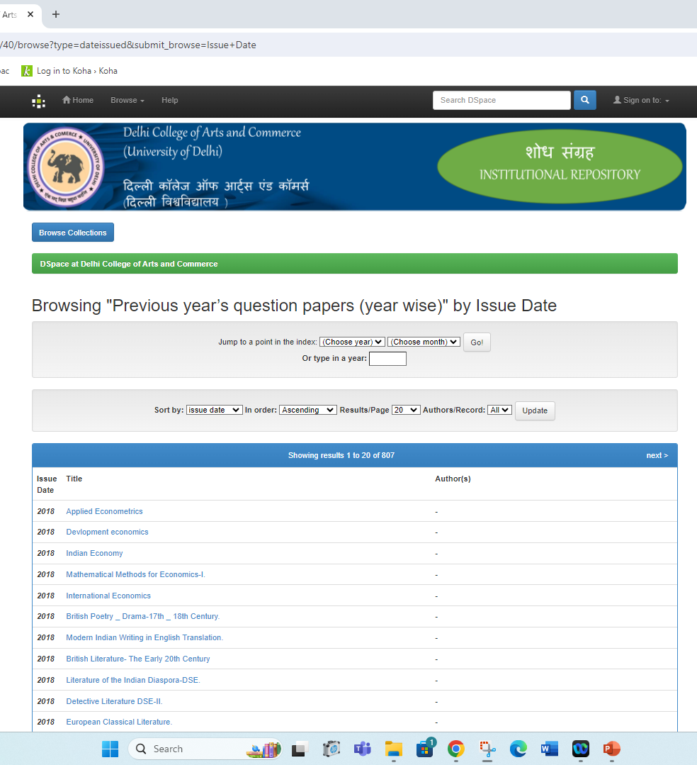
Step 13 : List of the previous question papers

Slide 15
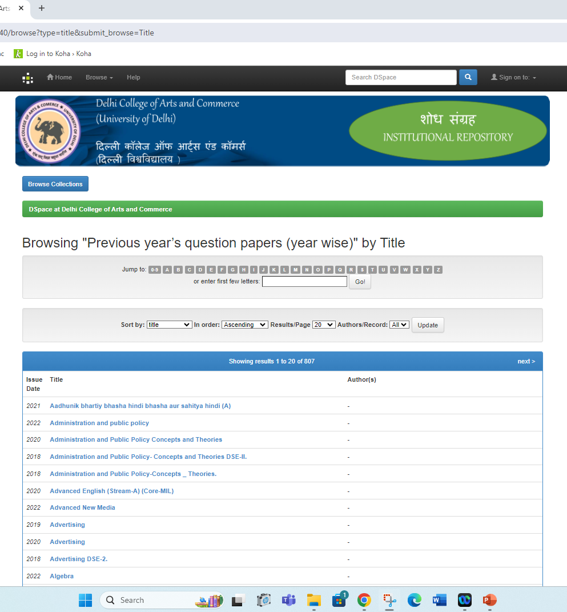
Step 14: You can also Search the desired question paper author wise, title wise, subject wise etc.

Slide 16
Note: Users can access other communities, such as library activities, annual reports, theses, and dissertations, in the same way as described for the Question Bank community.

Slide 17
THANK YOU

