Slide 1
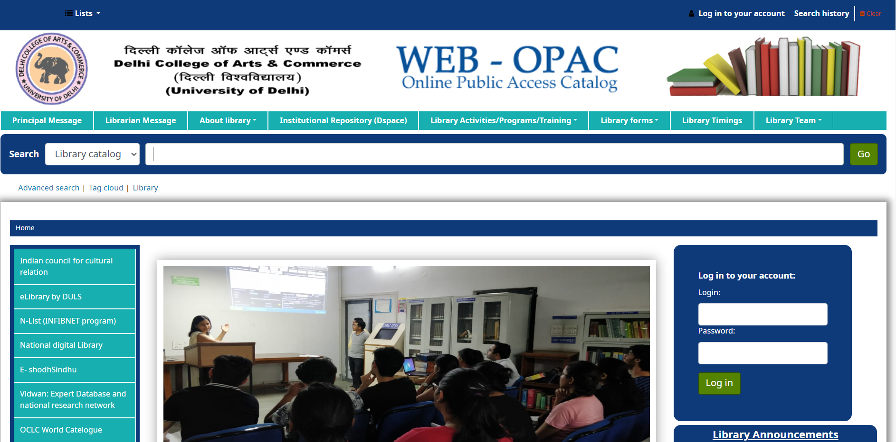
Step 1
Launch a web browser, go to https://dcac-opac.tiss.co.in, and wait for the home page of the Web OPAC to appear once the page has successfully loaded.

Slide 2
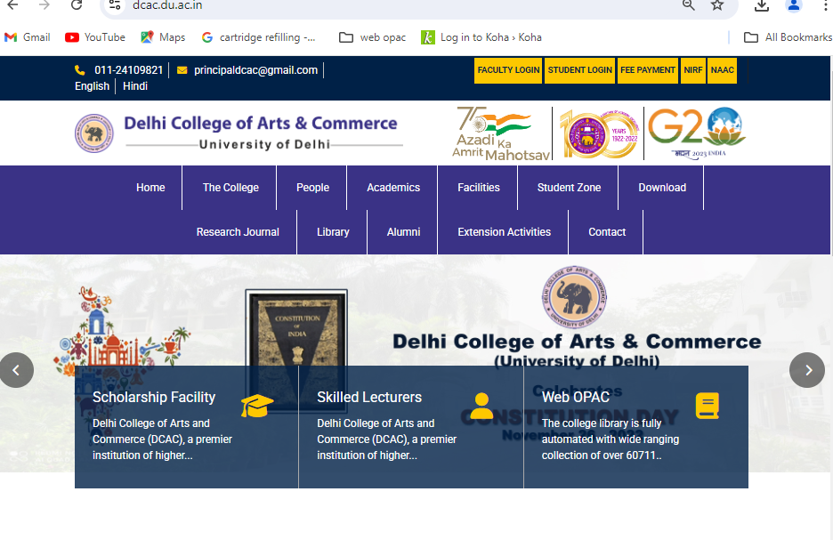
Step 2
Alternative Access: Clicking on the “WEB OPAC” icon available on the DCAC college website.

Slide 3
Step 3: Search for Books
Use the search box to find books by Title, Author, Subject, ISBN, ISSN, Call Number and other criteria. The search results will include the location of the books on the shelf.

Slide 4
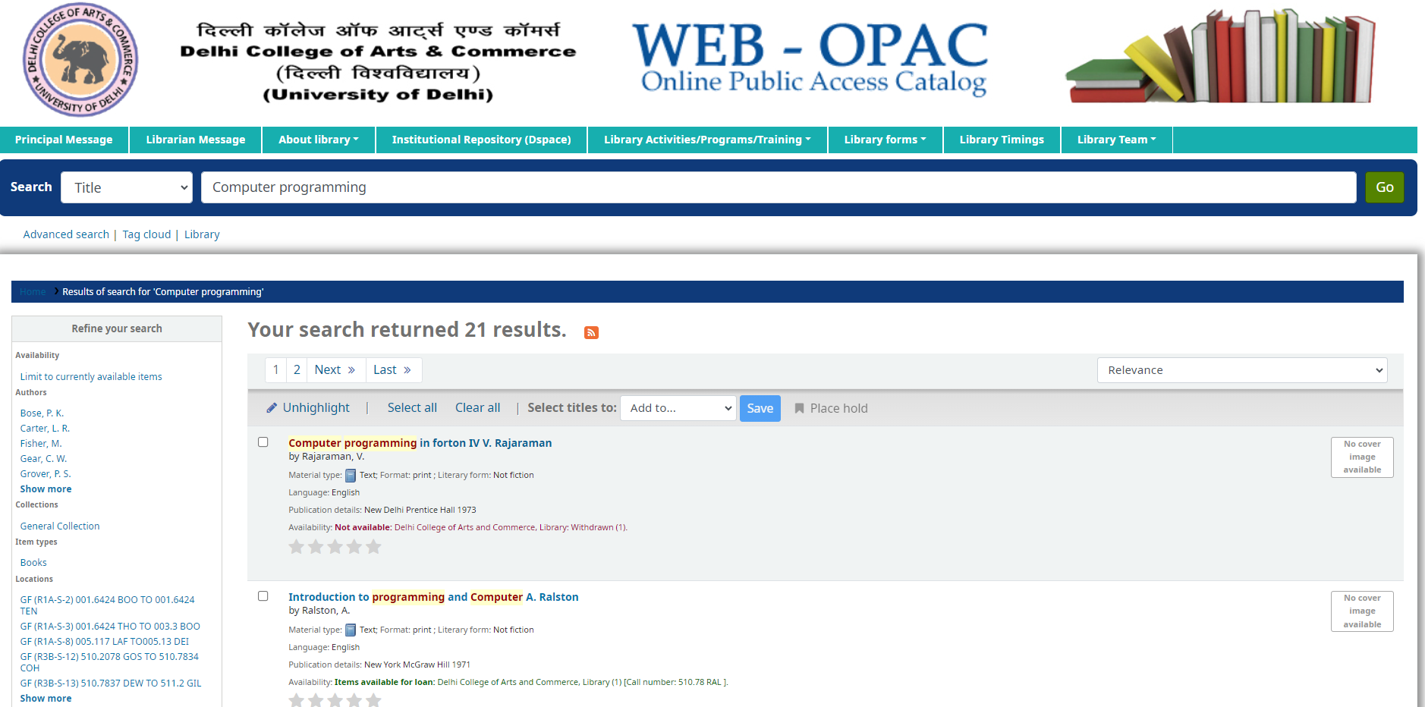
Step 4: Search book with title
Enter the book title into the search box and click "Go" to view the search results.

Slide 5
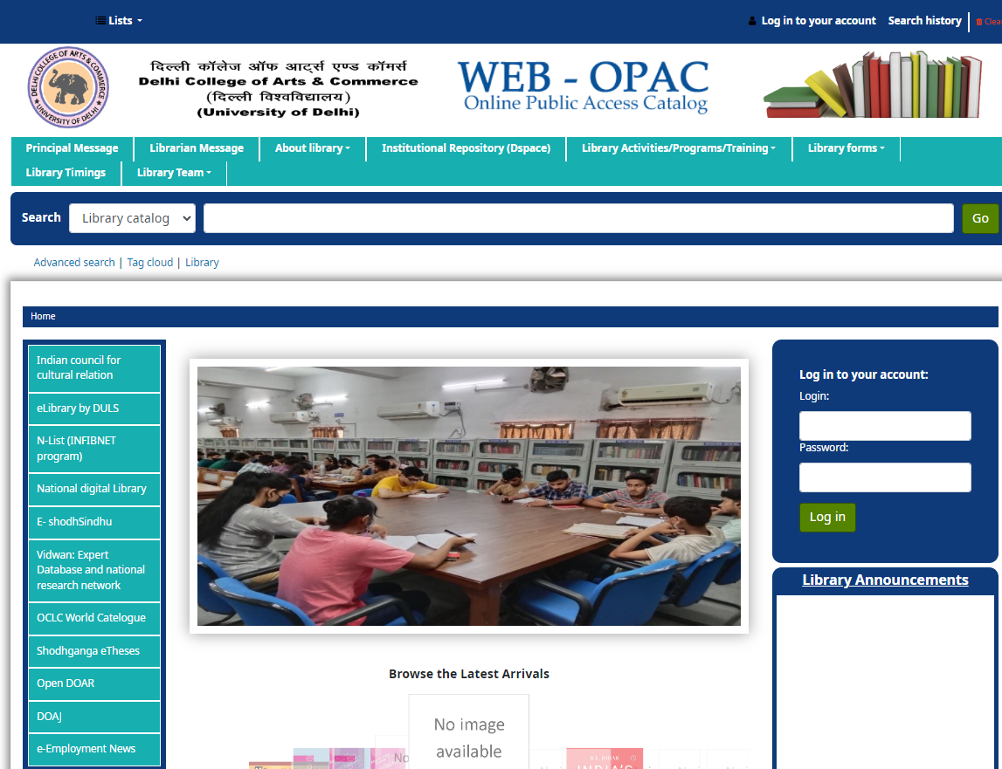
Step 3: Explore e-Resources
On the left side, explore the list of open access e-Resources and subscribed N-LIST e- resources.

Slide 6
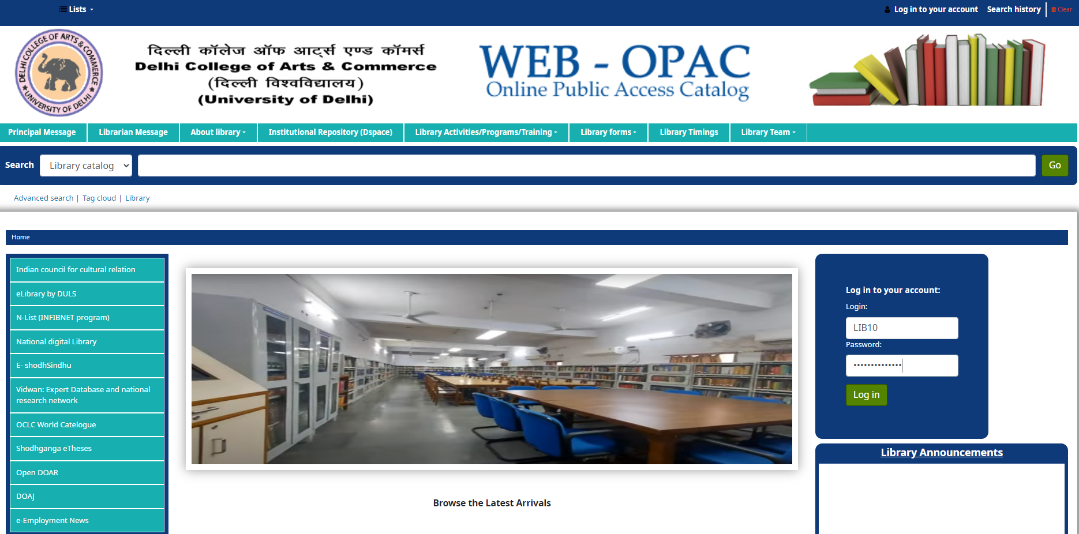
Step 4: Log in to your account using the following credentials:
Login ID: Enter your Member ID
Password: Enter your Member ID (Note: The default password is the same as your Member ID Number, as provided on your college ID card. Please change your password for security purposes.)

Slide 7
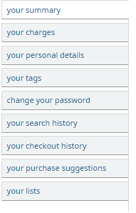
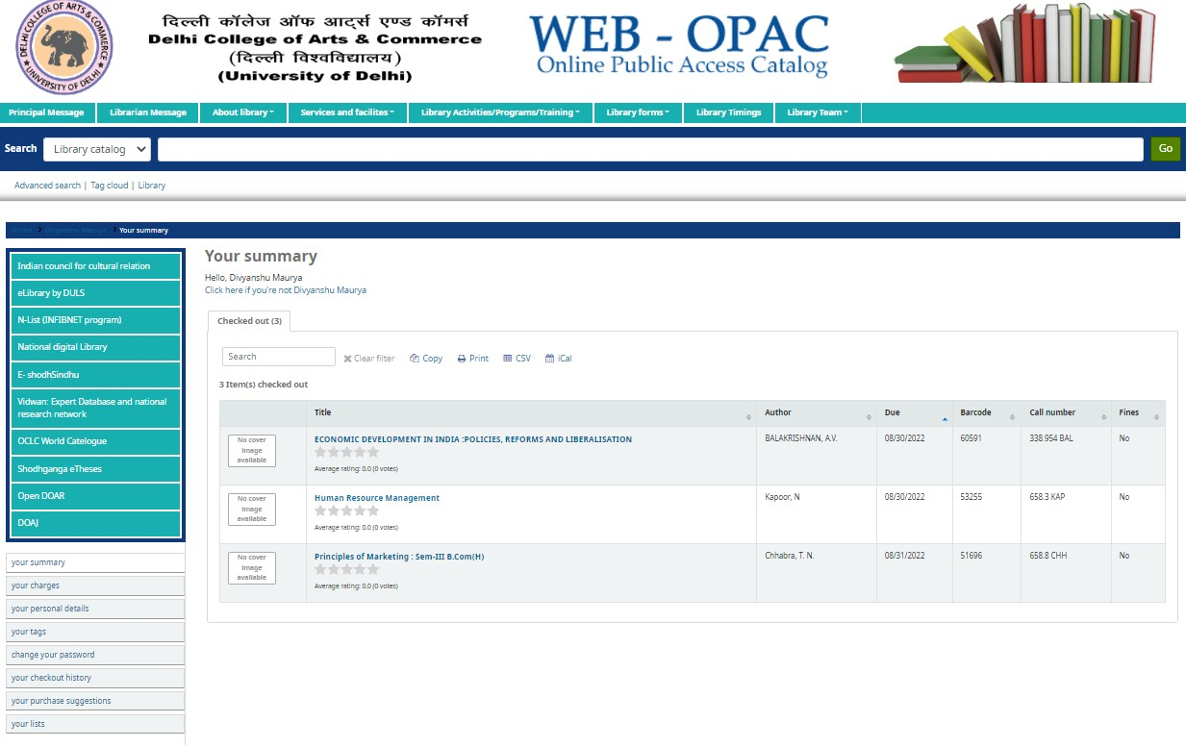
Step 5: Manage Your Account
After logging in, manage your account by checking book transactions, fine charges, personal details, checked-out books, overdue books, and more.

Slide 8
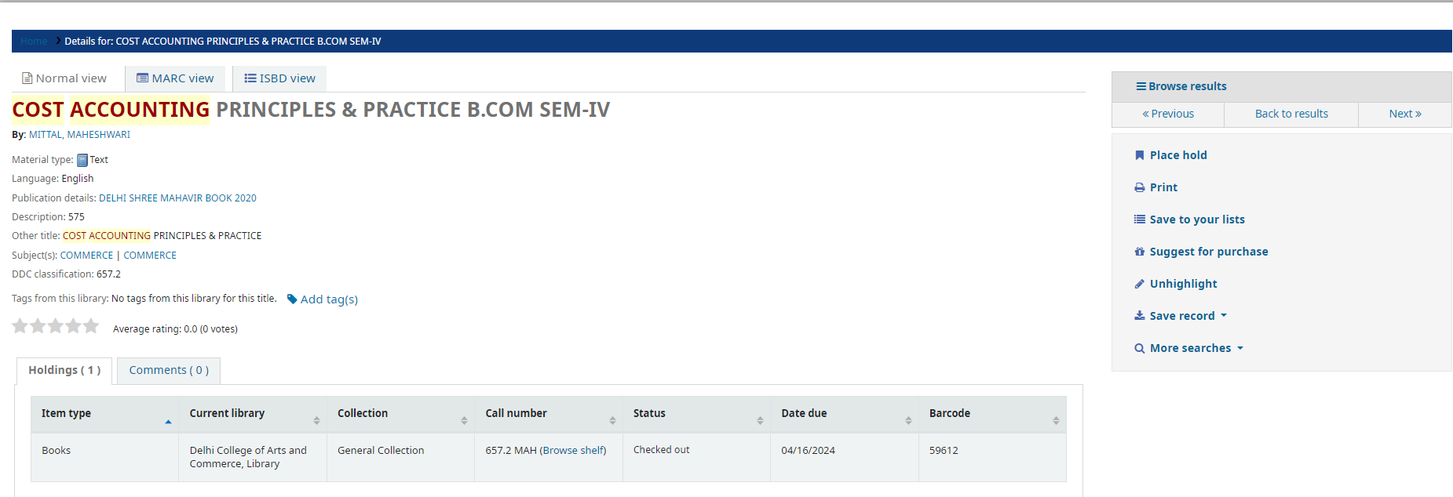
Step 6: Reserve Books
If a book is currently checked out, reserve it by clicking the “Place Hold” tab. You will be notified when the book is returned and available for checkout.

Slide 9
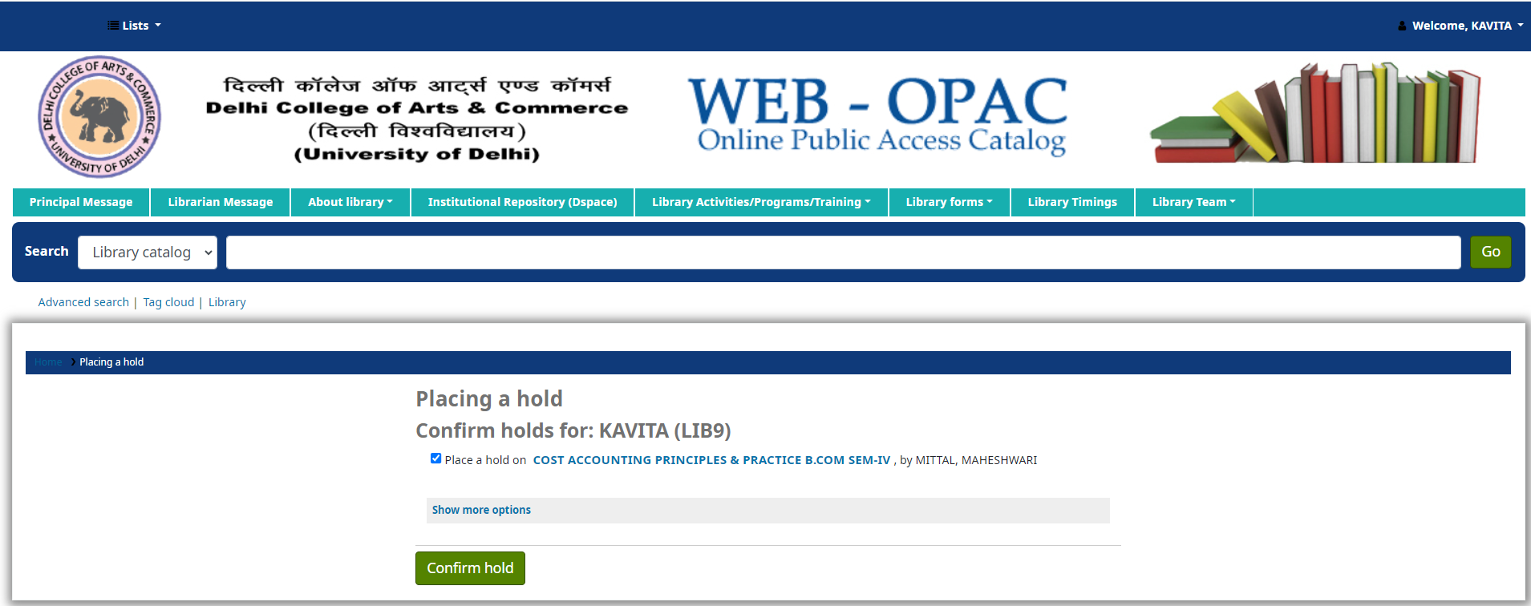
Step 7: Confirm Holds
After clicking "Place Hold," a new screen will appear to confirm your hold. Click on "Confirm Hold" to finalize the process.

Slide 10
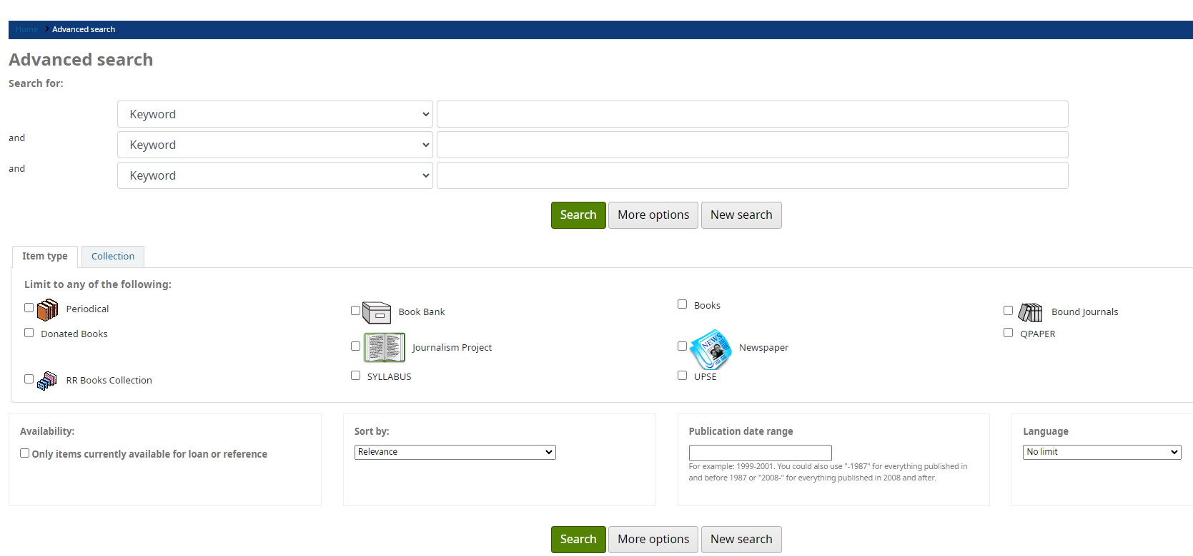
Step 8: Explore Library Resources
Use the Advanced Search tab in the Web OPAC to find books, Journalism Projects, Periodicals, Newspapers, Syllabus, Bound Journals, Previous Year Question Papers etc. and their locations.

